Slide 1

SESHADRI RAO GUDLAVALLERU ENGINEERING COLLEGE Department of Electronics and Communication Engineering
IOT Project On Smart Solutions for Railways Based on IOT
Presented by
K. Baby Amulya (20485A0406)
K. Monalika (20485A0408)
I. Swathi (19481A0479)
K. Usha Sri (19481A04A8)
M. Hiranmayi (20485A0411)

Slide 2
OBJECTIVE
IoT technologies help railways successfully manage passenger safety, operational efficiency, and the passenger experience. Smart sensors can be used to track important assets, manage passenger flow, and enable predictive maintenance. The Corporate aim of the Indian Railways is to commit itself to ensuring that all its activities are managed to the highest level of safety which is pragmatic and reasonably practicable to achieve.

Slide 3
ABSTRACT
The main purpose of this project is to book the seats based on the availability of the status of the status and in this we can also track our live location with the help of world map provided included in it. Generally this is an smart application in which we can have registration and tracking the live location and it provide a facility to book the food also. It looks simply like a smart app for railways based on IOT.

Slide 4
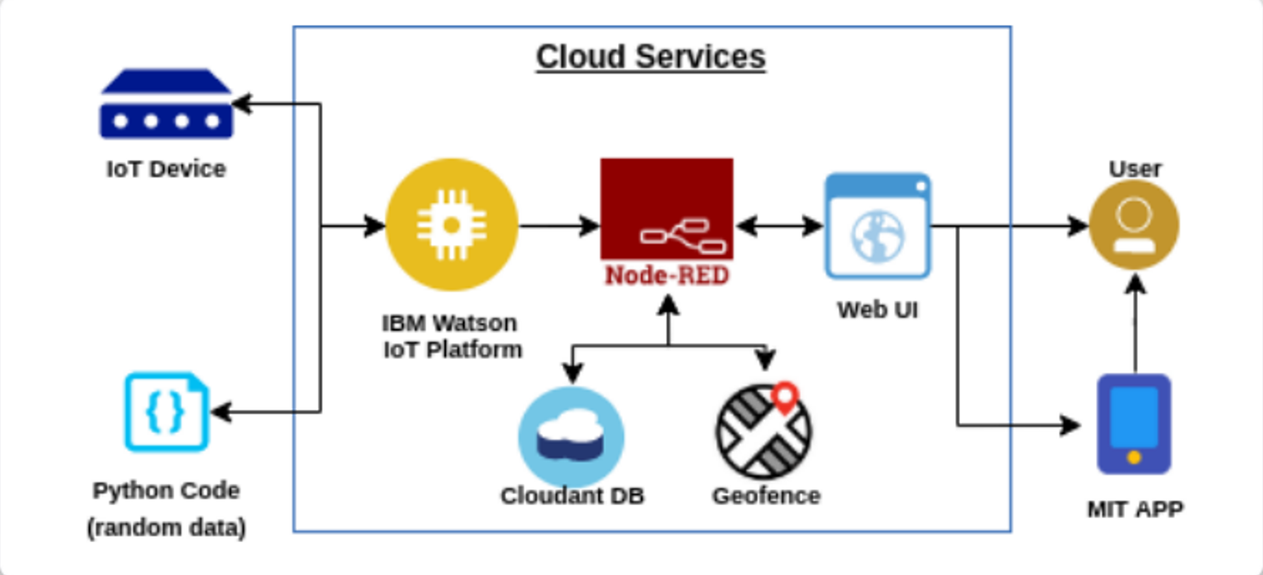
WORK FLOW OF THE PROJECT

Slide 5
PYTHON CODE:
import time
import wiotp.sdk.device
import sys
import random
import requests
#Provide your IBM Watson Device Credentials
myConfig = {
"identity": {
"orgId": "z9ibk2",
"typeId": "iotdevice",
"deviceId":"1234"
},
"auth": {
"token": "e7_!EIVKPQ)S2_k6Qm"
}
}
def myCommandCallback(cmd):
print("Message received from IBM IoT Platform: %s" %

Slide 6
cmd.data['command'])
m=cmd.data['command']
client = wiotp.sdk.device.DeviceClient(config=myConfig, logHandlers=None)
client.connect()
def pub(data):
client.publishEvent(eventId="status", msgFormat="json", data=myData, qos=0, onPublish=None)
print("Published data Successfully: %s", myData)
while True:
myData={'name':'Train1','lat': 8.0883,'lon': 77.5385}
pub(myData)
time.sleep(3)
myData={'name':'Train1','lat': 13.0827,'lon': 80.2707}
pub(myData)
time.sleep(3)

Slide 7
myData={'name':'Train1','lat': 12.9716,'lon': 77.5946}
pub(myData)
time.sleep(3)
myData={'name':'Train1','lat': 17.3850,'lon': 78.4867}
pub(myData)
time.sleep(3)
myData={'name':'Train1','lat': 23.2599,'lon': 77.4126}
pub(myData)
time.sleep(3)
myData={'name':'Train1','lat': 28.7041,'lon': 77.1025}
pub(myData)
time.sleep(3)
myData={'name':'Train1','lat': 33.2778,'lon': 75.3412}
pub(myData)
time.sleep(3)
client.commandCallback = myCommandCallback
client.disconnect()

Slide 8
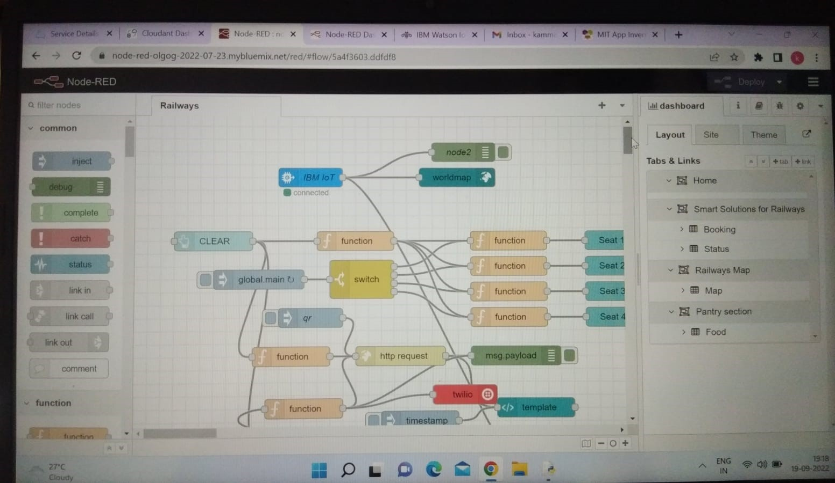
NODE RED FLOW

Slide 9
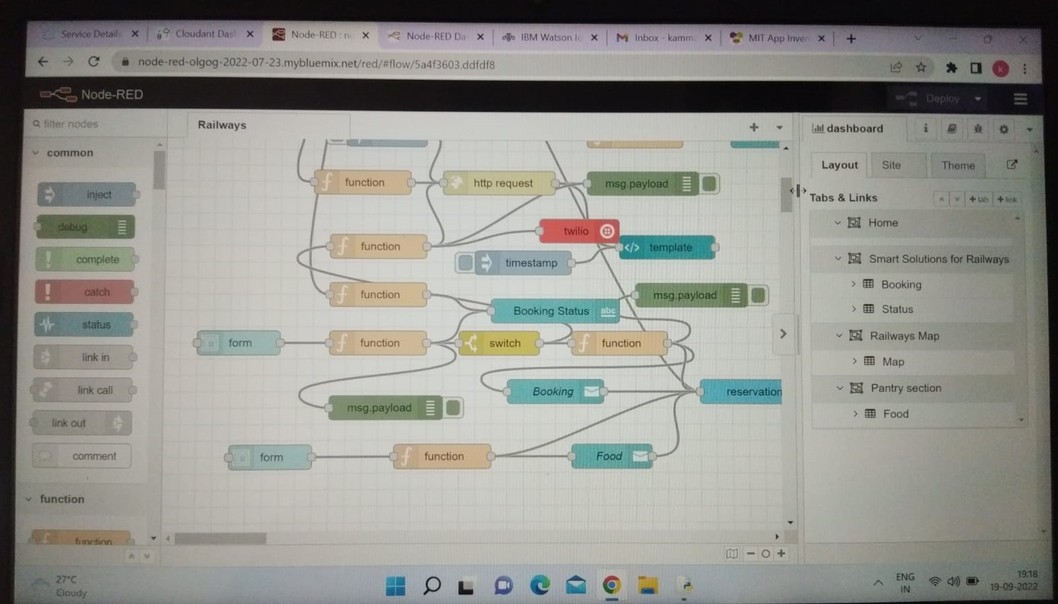

Slide 10
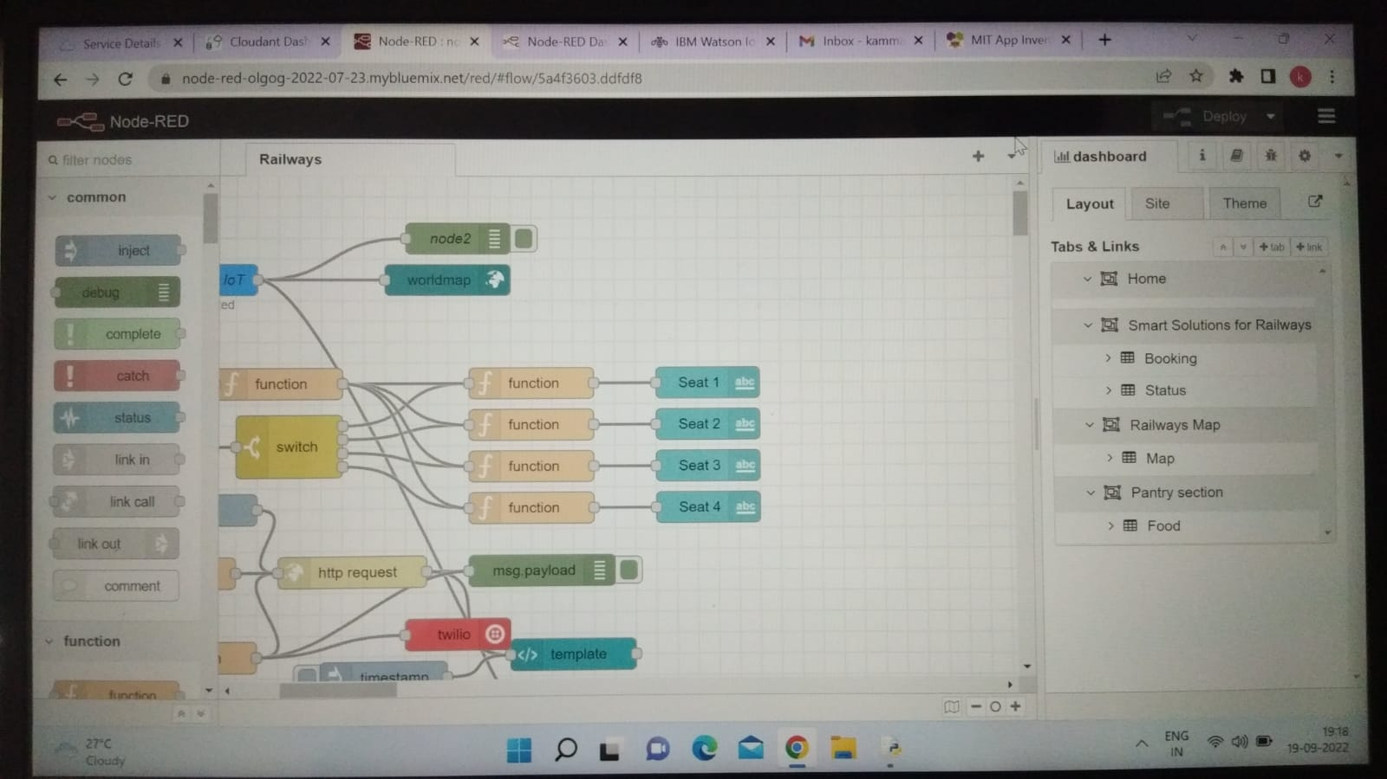

Slide 11
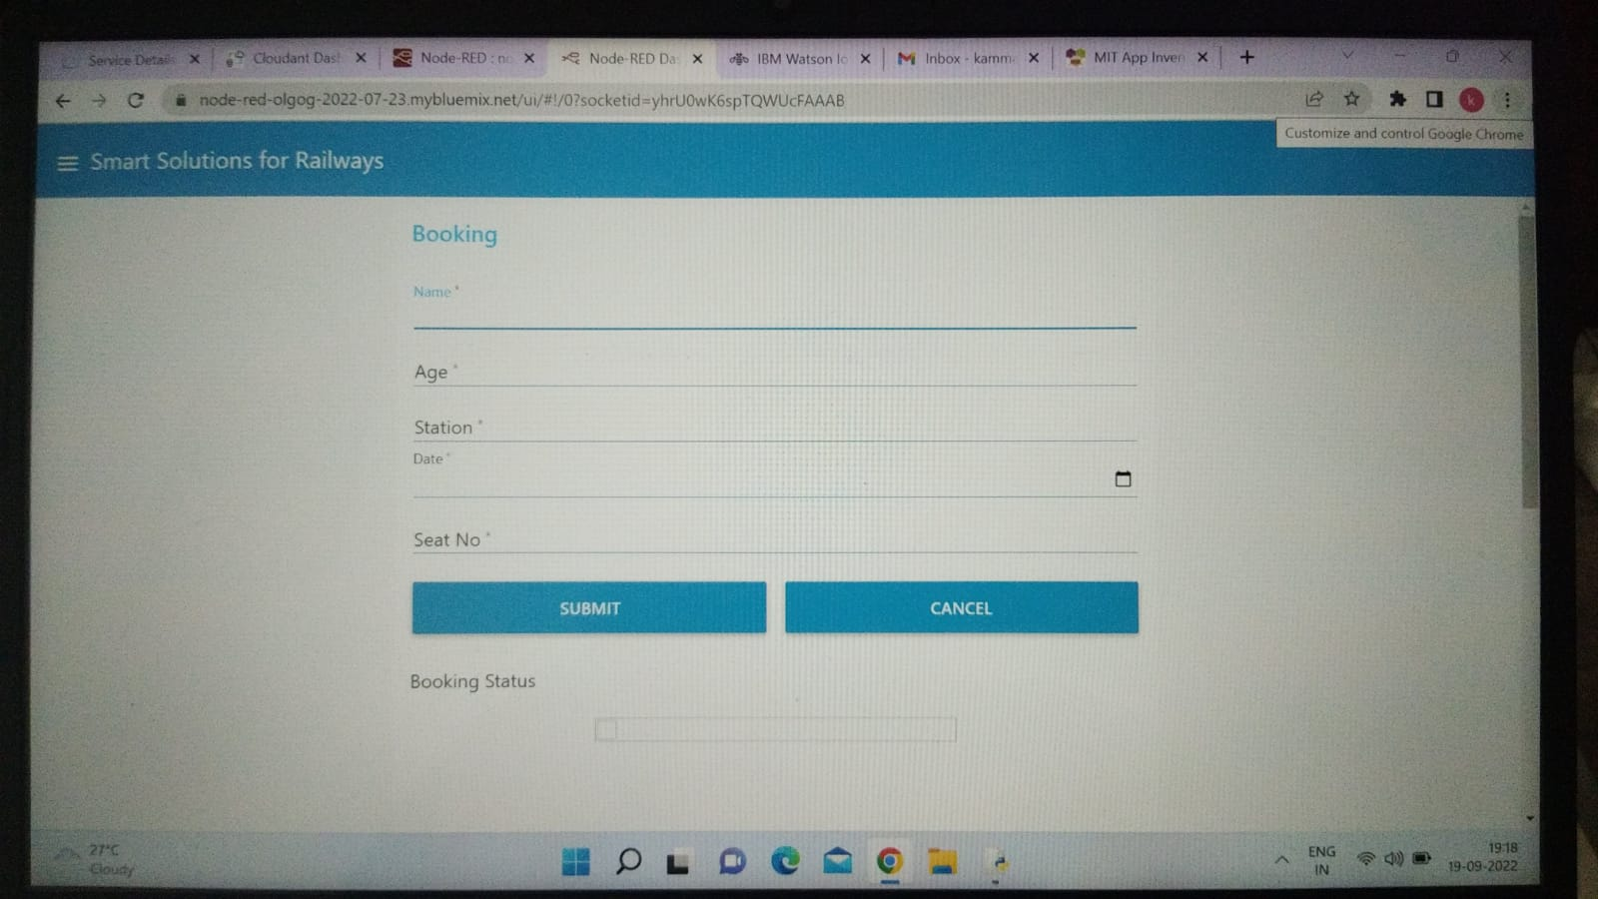
BOOKING STATUS

Slide 12
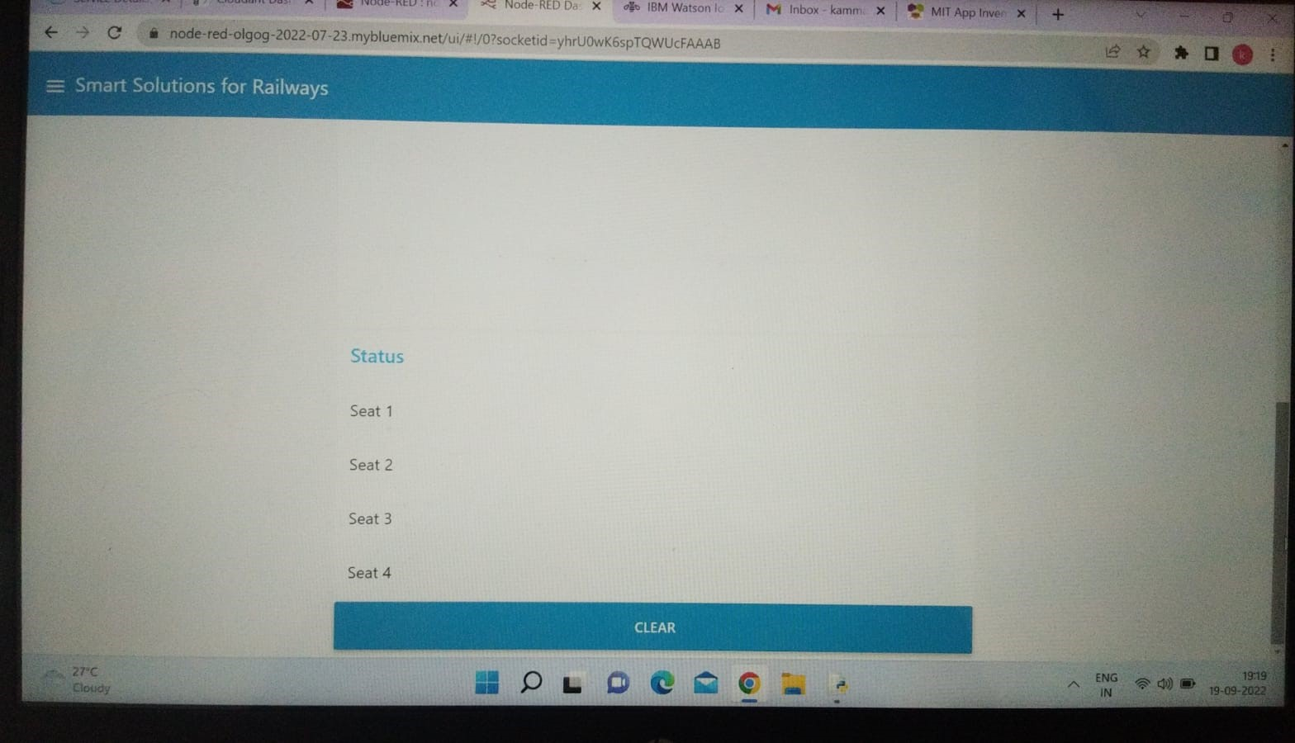

Slide 13
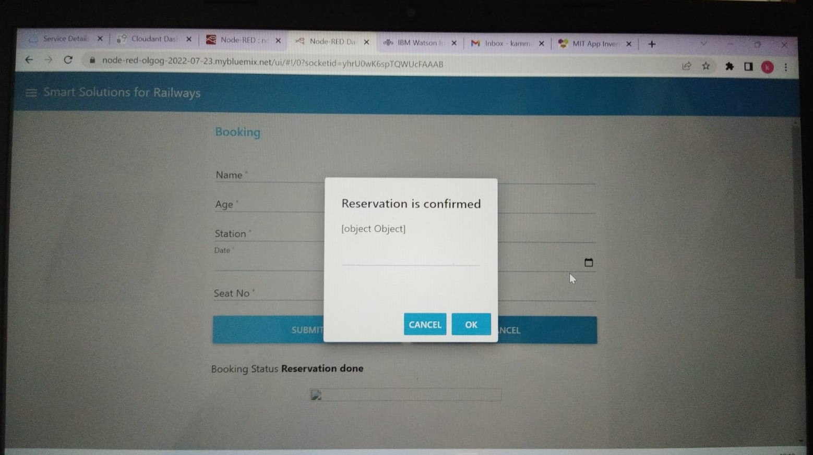

Slide 14
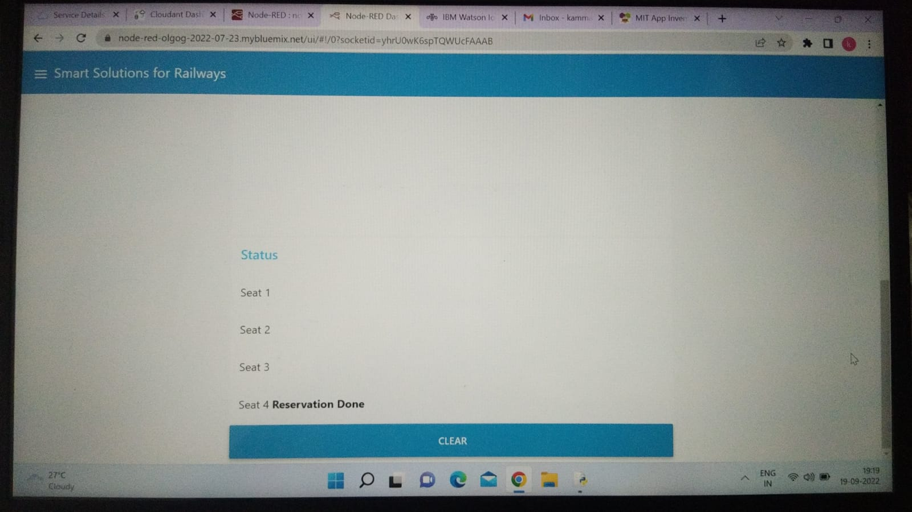

Slide 15
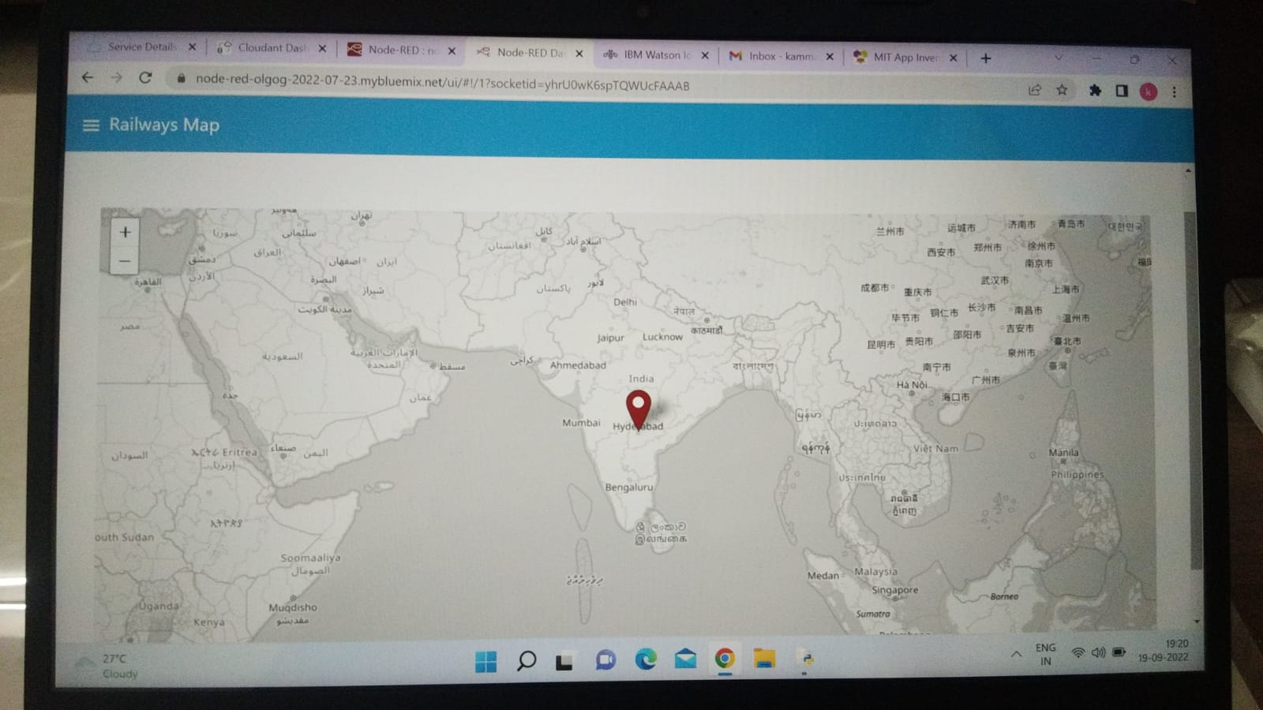
WORLD MAP

Slide 16
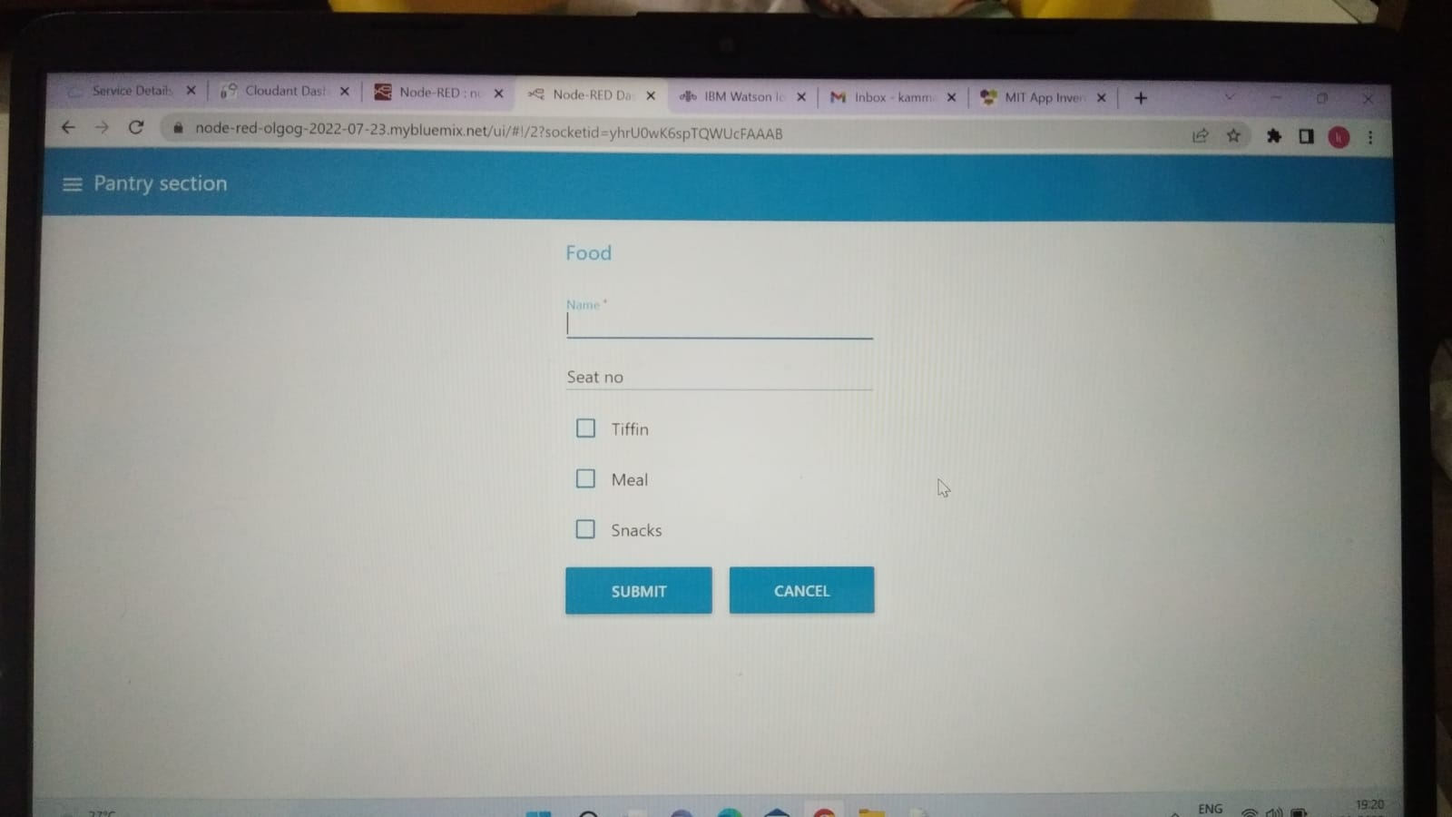
PANTRY SECTION

Slide 17
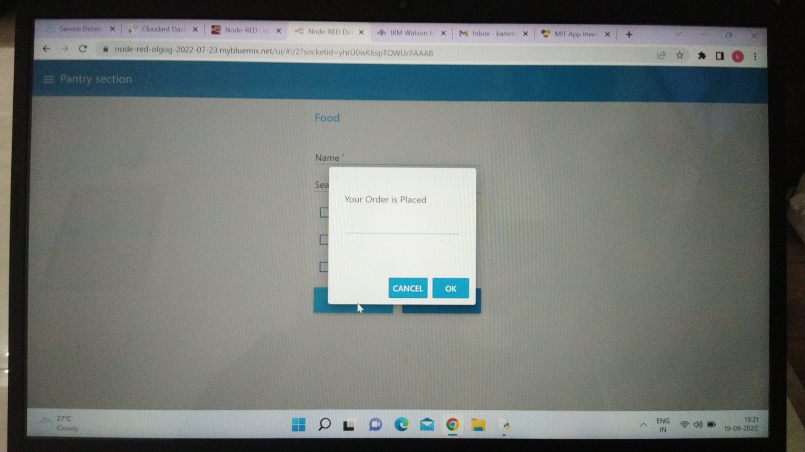

Slide 18
THANK YOU

